Slide 1


– HubSpot Support
Overview
Edvance is a specialized member-benefit company focused on higher education. They provide expertise and resources to develop program, promotional, and operational alignment, ensuring a seamless partner and student experience.
To improve the informational flow for potential students, Edvance needed a comprehensive solution to handle various types of information, such as general details, admissions, transcripts, costs and more.
Affirma implemented HubSpot Service Hub as a solution. Service Hub with its numerous features, including help desk, ticketing and knowledge base could serve as a centralized repository for frequently asked questions and other relevant information, organized by university.
Affirma Support
Performed comprehensive HubSpot assessment and provided findings and recommendations
Configured and set-up Service Hub ensuring all features were fully operational.
Managed domain name and URL settings to ensure seamless integration and accessibility.
Defined overall design of Knowledge Base to align with Edvance's branding and user experience.
Created necessary landing pages to house information for each university, covering topics such as general information, admissions, transcripts, and costs.
Conducted thorough testing to confirm functionality.
Provided best practices and training for self-management.

Slide 2
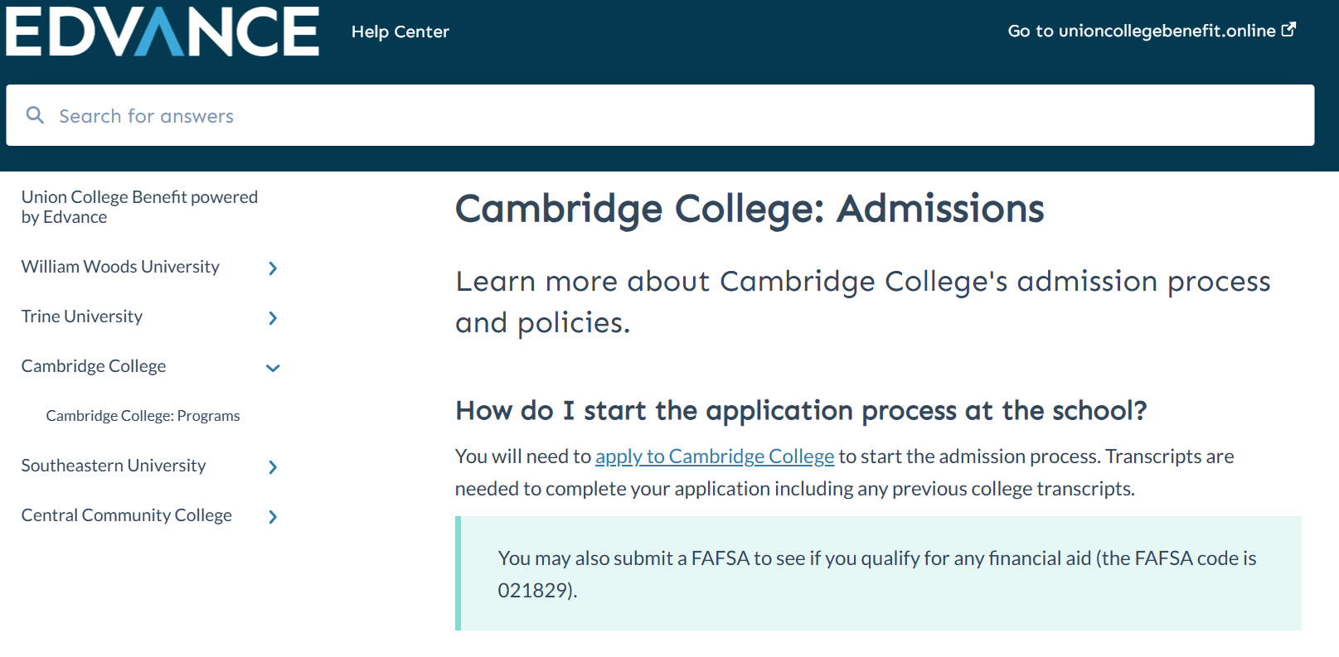
Edvance HubSpot Service Hub

